Slide 1
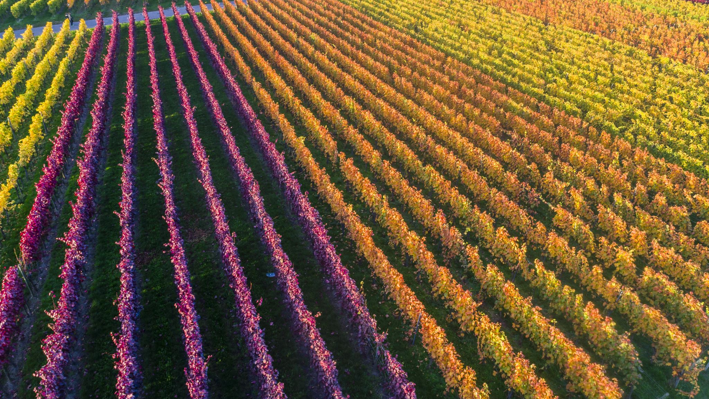
Bacchus Winery
CDJ Team
03/02/2025

Slide 2
CDJ Group Introduction
Casey Rose
Darreon Tolen
Jennifer Hoitenga
We worked together as a team, each contributing to the success of our project.
Addressed challenges through regular discussions.
Developed business rules, designed the ERD, built the database schema and tackled the reporting needs.

Slide 3
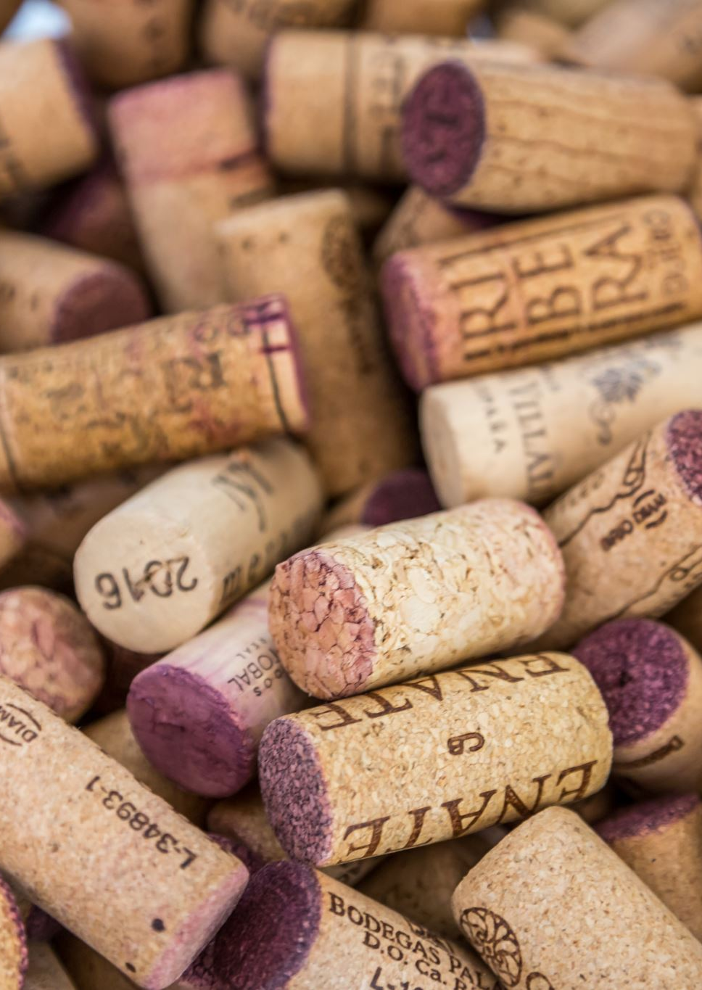
Case Study Background
Stan & Davis Bacchus inherited the winery three years ago.
Retained all staff to maintain stability.
Produces Merlot, Cabernet, Chablis & Chardonnay wines.
Orders supplies (bottles & corks, labels & boxes, vats & tubing) from three suppliers.
Challenges: Inventory tracking & order management need improvement.
Goal: Implement online systems for supply orders & distributor tracking.

Slide 4
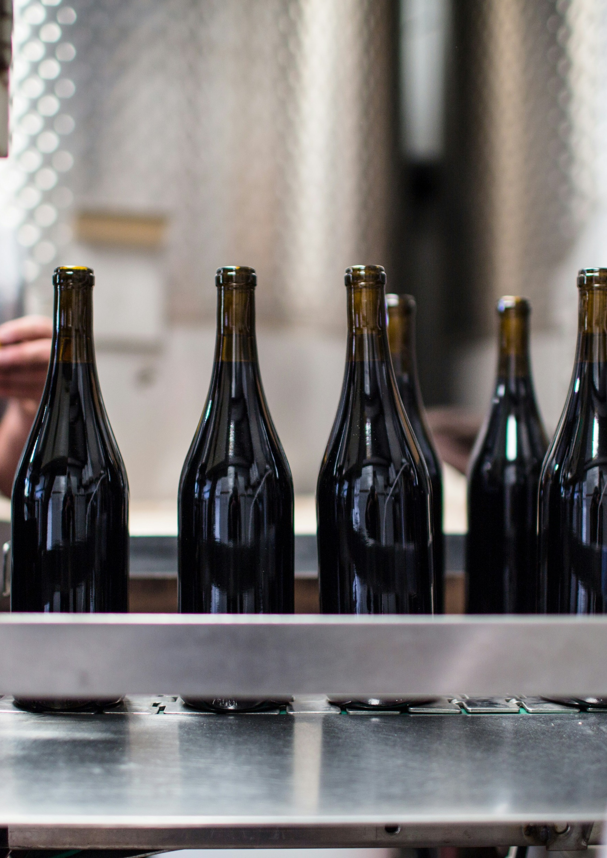
Case Study – Data Needs
Supplier Reliability – On-time deliveries? Delays? Monthly reports needed.
Wine Sales – Performance of each wine & distributor assignments.
Employee Hours – Total work hours per employee over the past year.

Slide 5
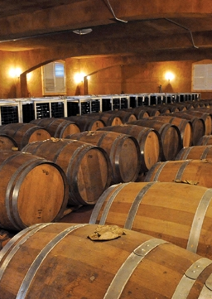
Business Rules
A WINERY has multiple EMPLOYEES
A WINERY buys multiple SUPPLIES
A WINERY produces multiple WINES
A WINERY records SALES transactions
A SUPPLY is provided by one SUPPLIER
Each SUPPLIER provides one or more SUPPLIES
A WINE can be sold multiple times
A SALE transaction includes one specific WINE
A SALE is made to one DISTRIBUTOR
A DISTRIBUTOR can purchase multiple types of WINE, but each sale transaction includes only one WINE
Each EMPLOYEE has a recorded number of hours worked

Slide 6
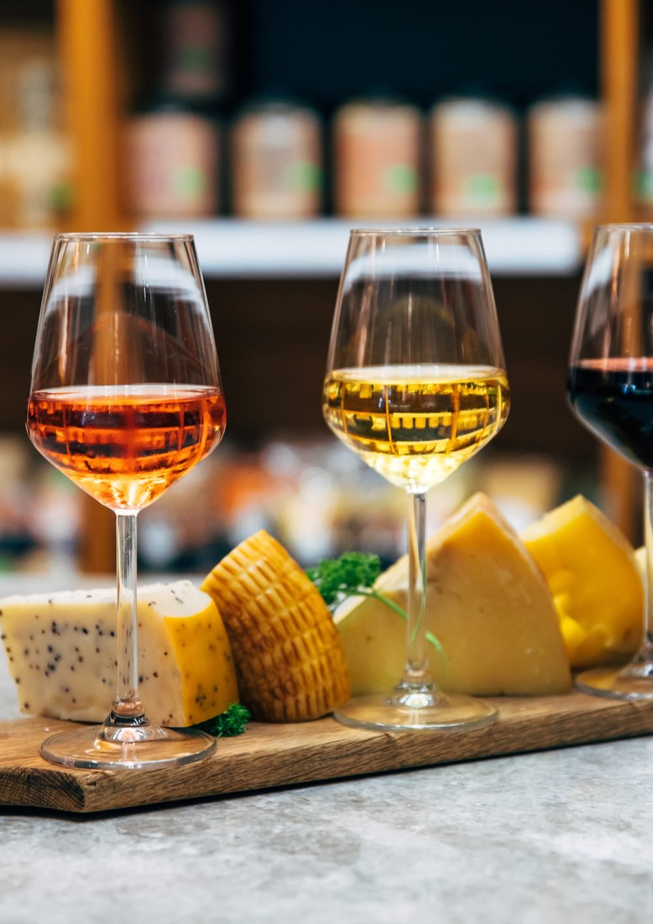
Assumptions Made
The winery operates with the assumption that each winery must have at least one employee but can exist without producing wine initially.
Supplies are ordered from suppliers with each supply order linked to a single supplier.
Deliveries are expected on a periodic basis with delays tracked against expected delivery dates.
Each wine has an inventory quantity that is actively managed.
Each distributor can purchase multiple types of wine but must do so through separate sales transactions.
Sales transactions are recorded per wine and distributors purchase directly from the winery with each sale linked to a single distributor.
Employee management assumes that each employee belongs to a specific department such as finance, marketing, production or distribution.
Work hours are tracked daily in a separate time management system. However, only the monthly totals for each employee are stored in this database and aggregated by quarter.

Slide 7
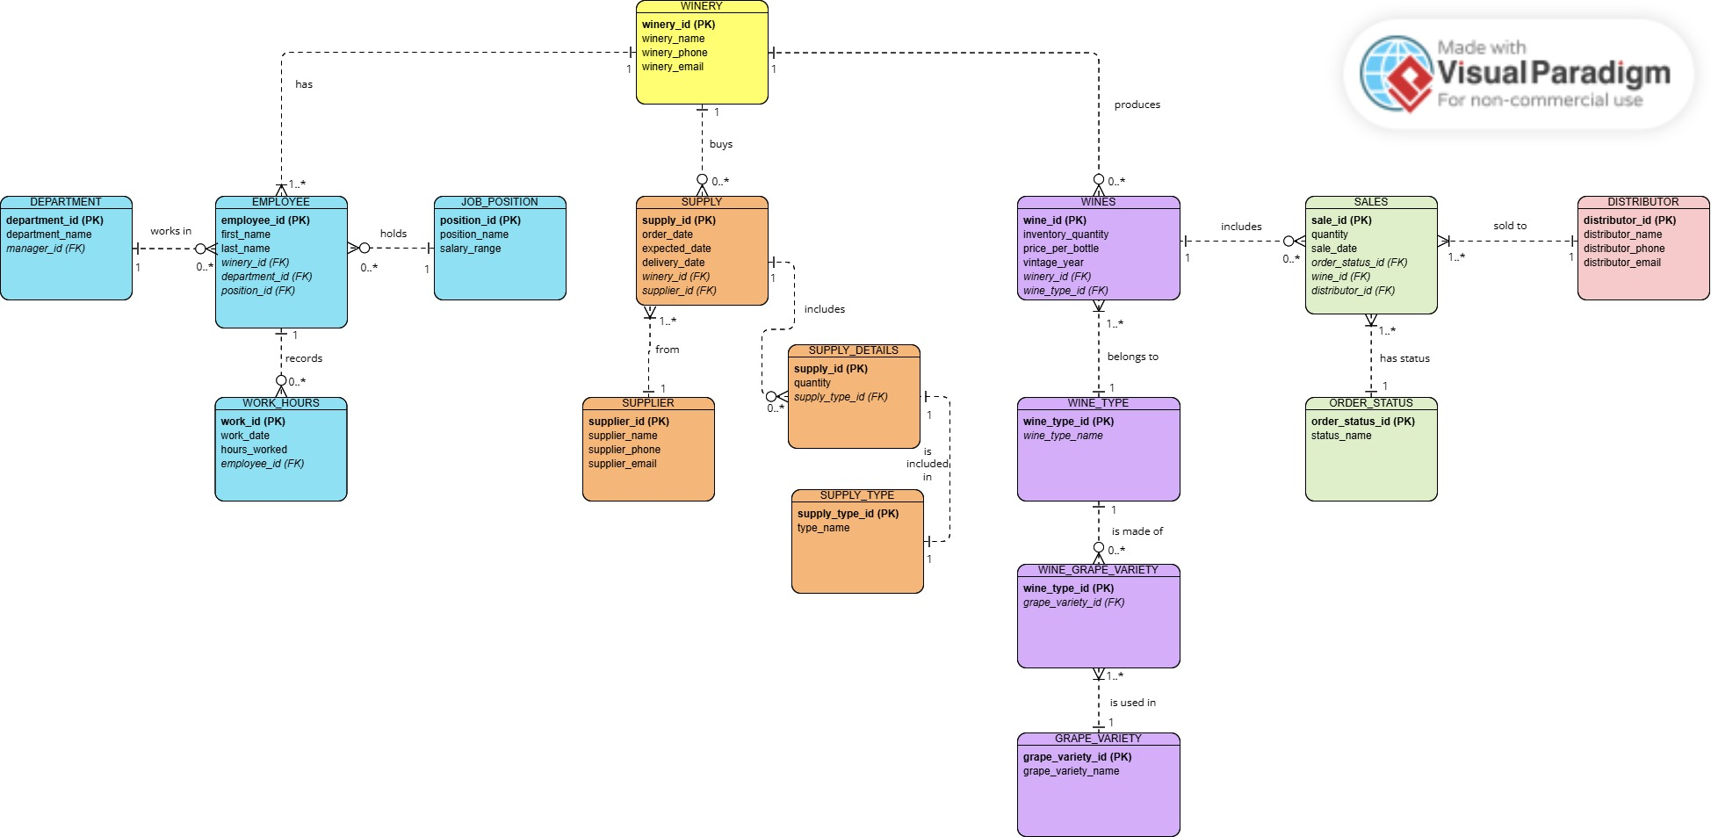
ERD

Slide 8
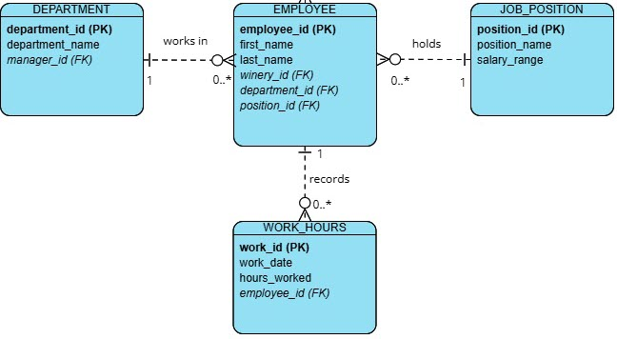
ERD - Employee
EMPLOYEE and DEPARTMENT have a MANY-to-ONE relationship. Each employee may be assigned to one department, but a department can have multiple employees.
EMPLOYEE and JOB_POSITION have a MANY-to-ONE relationship. Each employee holds one job position, but multiple employees can share the same position.
EMPLOYEE and WORK_HOURS have a ONE-to-MANY relationship. Each employee has multiple work hour records, with one entry per month stored in the database.

Slide 9
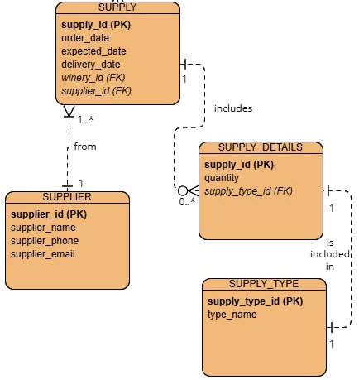
ERD - Supply
SUPPLY and SUPPLIER have a MANY-to-ONE relationship. Each supply order is placed with one supplier, but a supplier can fulfill multiple supply orders.
SUPPLY and SUPPLY_DETAILS have a ONE-to-MANY relationship. Each supply order can include multiple supply details (items in the order), but each supply detail belongs to a single supply order.
SUPPLY_DETAILS and SUPPLY_TYPE have a ONE-to-ONE relationship. Each supply detail corresponds to one supply type, but a supply type can be associated in multiple supply details.

Slide 10
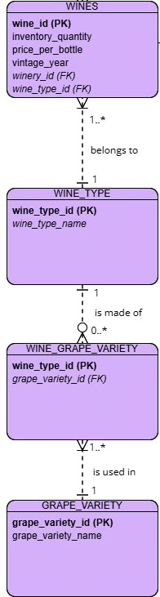
ERD - Wine
WINES and WINE_TYPE have a MANY-to-ONE relationship. Each wine belongs to a single wine type, but a wine type can be associated with multiple wines.
WINE_GRAPE_VARIETY and WINE_TYPE have a MANY-to-ONE relationship. Each record in the wine_grape_variety links one wine type to one grape variety. Multiple records can reference the same wine type, but each record corresponds to a single wine type.
WINE_GRAPE_VARIETY and GRAPE_VARIETY have a MANY-to-ONE relationship. Each record in the wine_grape_variety corresponds to one grape_variety, but a grape variety can be used in multiple tine types.

Slide 11
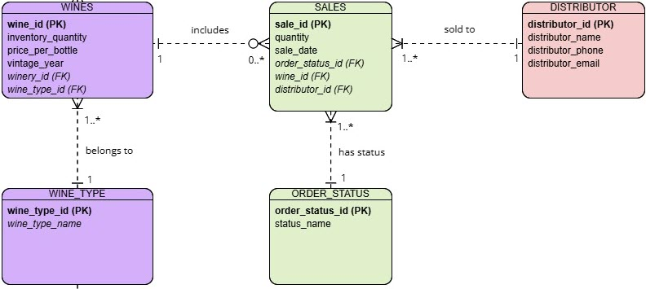
ERD - Sales
SALES and WINES have a MANY-to-ONE relationship. Each sale transaction involves a single wine, but a wine can be sold in multiple transactions.
SALES and ORDER_STATUS have a MANY-to-ONE relationship. Each sales transaction is assigned a single order status, but an order status can be associated with multiple sales transactions.
SALES and DISTRIBUTOR have a MANY-to-ONE relationship. Each sales transaction is made to a single distributor, but a distributor can be involved in multiple sales transactions.

Slide 12
Supplier Report Needs & Development Process
The Bacchus winery wanted to know if all suppliers were delivering on time, if there was a gap between expected delivery and actual delivery and they wanted a month-by-month report.
To achieve this, we developed a report that analyzes supplier deliveries by comparing the expected delivery date with the actual delivery date for each order. This report calculates the total delay days per order.
Additionally, we created a bar chart to visualize monthly supplier delays, making it easier to identify trends and pinpoint recurring issues.

Slide 13
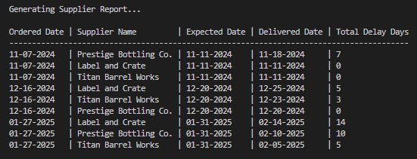
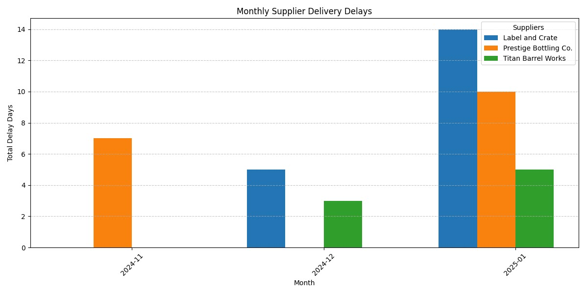
Supplier Reports Overview

Slide 14
Supplier – Actionable Steps for Frequent Delays
If the winery faces frequent delays, the following actionable steps can be implemented:
Evaluate how supplier delays affect inventory, production and sales.
Communicate with the supplier and discuss root causes, set expectations and request an improvement plan.
Explore alternative suppliers, consider local suppliers or vet new suppliers.
Negotiate better terms and include penalties for delays.
Establish safety stock for essential supplies to avoid shortages.
Develop emergency sourcing and alternative supply chain pathways.

Slide 15
Wine Report Needs & Development Process
The Bacchus winery wanted to know if all wines are selling as they thought, is one wine not selling and which distributor carries which wine.
To achieve this, we developed three reports. The first report retrieves sales data corresponding to the month, sale id, quantity, wine type and distributor name. The results are sorted by sale date (month), sale id and distributor name.
We also generated a bar chart to illustrate which wines were sold by each distributor and to identify the least sold wine making it analyze sales distribution and spot underperforming products.
Additionally, we created a report grouped by distributor to determine if certain distributors were selling significantly more wine than others.

Slide 16
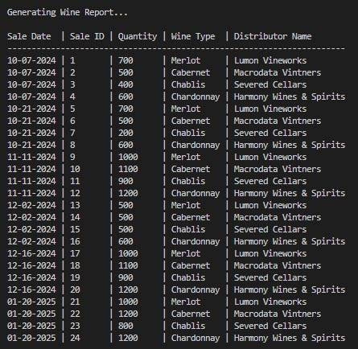
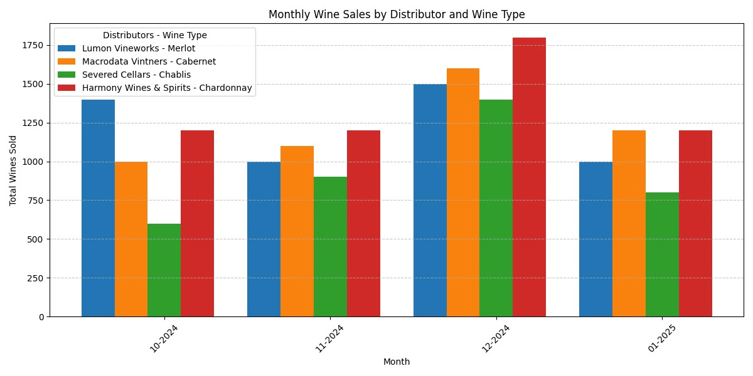
Wine Reports Overview

Slide 17
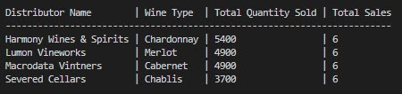
Wine Report – By Distributor Overview
To boost sales, the Bacchus winery could offer the following incentives:
Offer discounts for larger order volumes.
Offer bonuses for distributors who exceed sales quotas.
Create a recognition program that rewards high performing distributors.
Run sale contests with prizes.

Slide 18
Employee Time Report Needs & Development Process
The Bacchus winery wanted to know during the last four quarters, how many hours did each employee work?
To achieve this, we first totaled each employee’s work hours by quarter.
We then developed a report that returns a list of employees along with the total hours they worked per quarter. The results are sorted by employee id.
We also created a bar chart displaying the total average hours worked by department over the last four quarters. This provides the winery with insights into whether certain departments are working more hours than others, offering a full year’s perspective on workforce distribution.

Slide 19
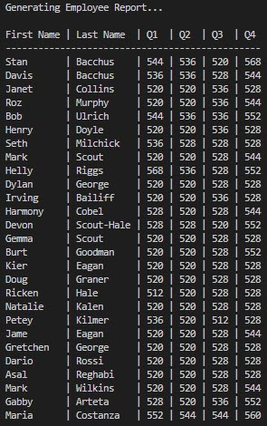
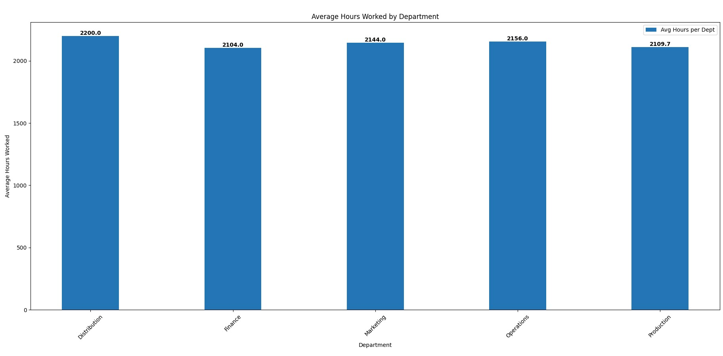
Employee Time Reports Overview

Slide 20
Employee Time – Actionable Insights
The Bacchus winery can optimize workforce management by:
Adjusting work shifts based on department workload trends.
Identifying excessive overtime and redistribute workload more effectively.
Allocating resources where they are needed most.
Preventing burnout by ensuring a balanced distribution of hours.
Using historical data to forecast labor costs and improve financial planning.

Slide 21
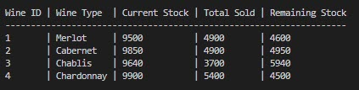
Inventory Tracking Overview
The Bacchus winery indicated that inventory tracking was a challenge for them. Although this was not listed as one of the data needs for the case study, the CDJ team wanted to demonstrate how the system could monitor these levels.
We created an Inventory Tracking report that calculates the total quantity sold for each wine based on sale transactions and displays the remaining stock.
While not implemented, a further enhancement could be a stored procedure that automatically updates stock levels in real-time after each sale, reducing manual tracking.

Slide 22
Expanding Distributor & Wine Relationships
Current Setup
Each distributor can make multiple purchases.
Each individual sale only includes one type of wine.
A distributor is not restricted in purchasing a specific wine, they can buy different wines across multiple sales.
This relationship is one-to-many (one distributor → multiple sales, each for a single wine).
Future Change
If the business needs evolve, distributors may need to purchase multiple wine types within a single sale.
This shift would change the relationship from one-to-many to many-to-many, requiring adjustments to the database structure.
A many-to-many setup would allow a single sale to include multiple wine types, improving flexibility in order processing.

Slide 23
Conclusion and Takeaways
Project Success
Developed a structured, optimized database to enhance inventory management, order processing and business tracking.
Ensured data integrity, efficiency and scalability for future business growth.
Lessons Learned
Importance of clear business rules and well-defined ERD design.
The importance of normalization in reducing redundancy and improving database efficiency.
The impact of overlooking many-to-many relationships during initial design.

Slide 24
Thank you!

